Slide 1

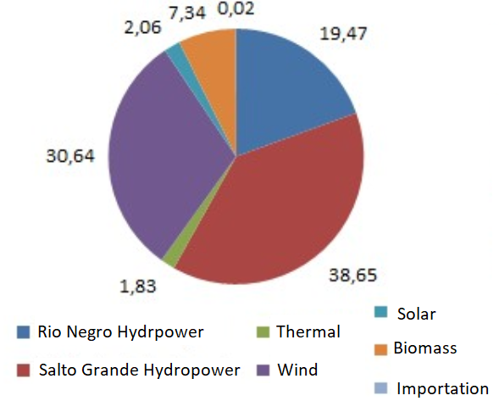
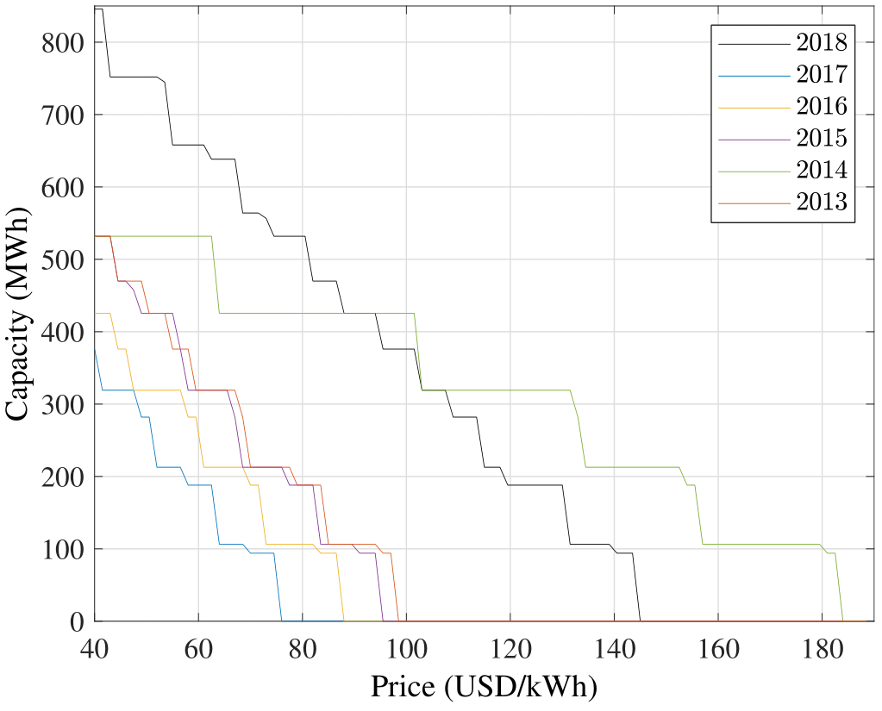
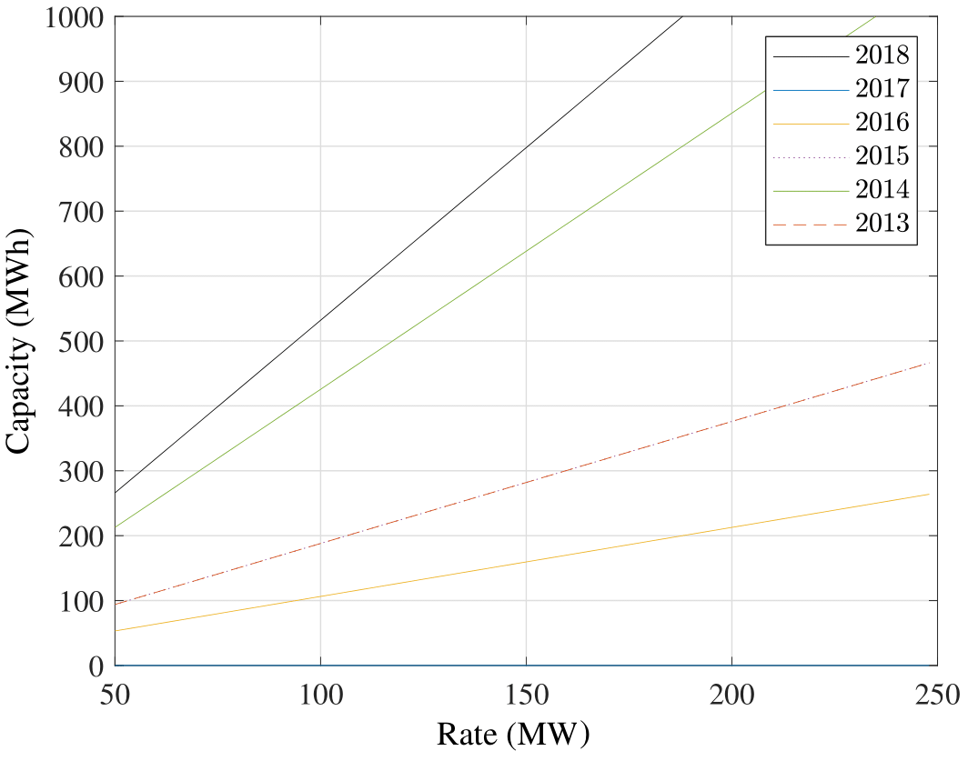
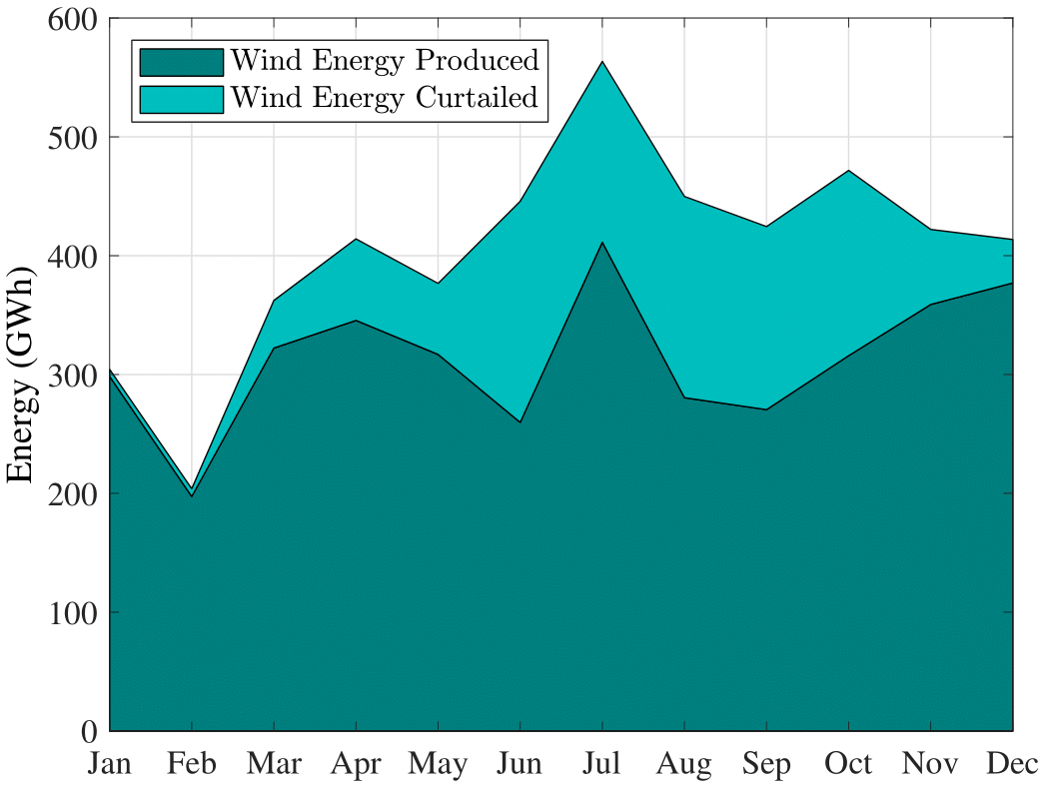
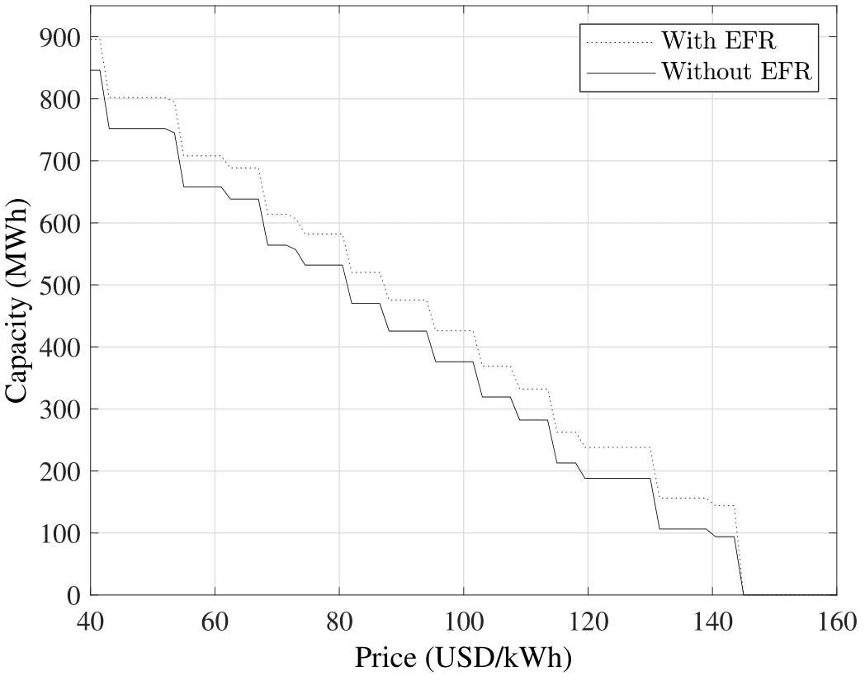
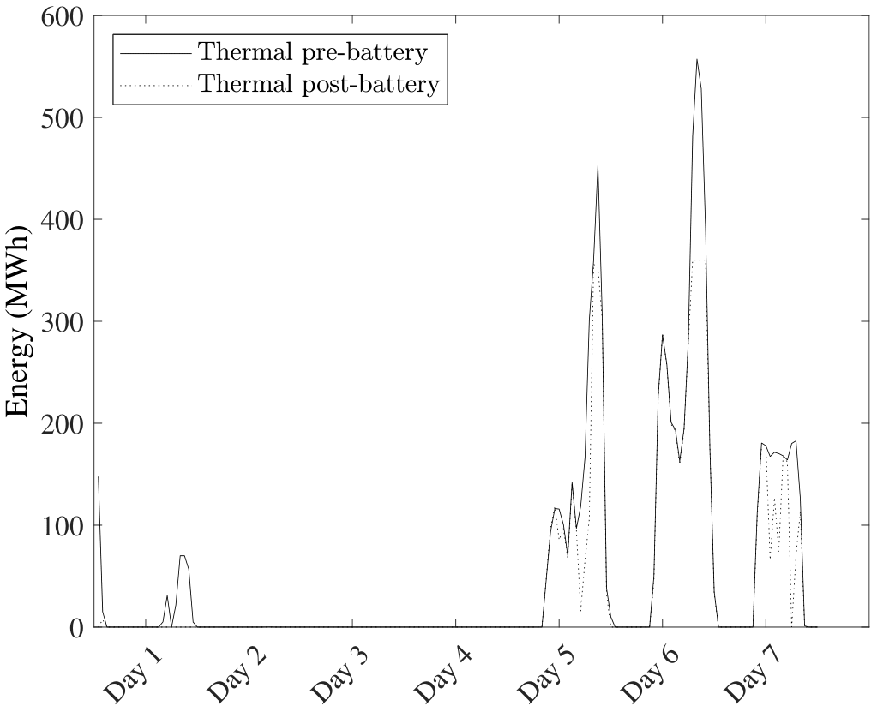
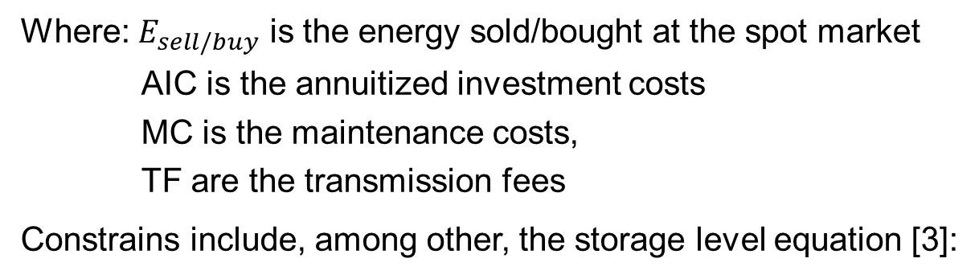





APPLICATION OF ENERGY STORAGE IN SYSTEMS WITH LARGE PENETRATION OF INTERMITTENT RENEWABLES
Author: Lucas Narbondo
Supervisor: Goran Strbac and Paola Falugi
MOTIVATIONS
Ten years ago, Uruguayan generation was composed by 1450MW of hydropower (65% of installed capacity), 700MW of Thermal Power (32%) and 70MW of energy generated from biomass (3%).
The country implemented policies to favour the incorporation of non-conventional renewable energy and today clean generation provides almost 95% of the electricity consumption, as seen in the Figure below [1].
RESULTS
Private investor perspective
The Figure below shows the optimal capacity to be installed as a function of the battery price when fixing the battery charge/discharge rate to 100MW and as a function of the rate when fixing the price to 80USD/kWh, where we can observe that rainy years (2017, 2016, 2015, 2013) are not very attractive because of low spot prices.
However, Uruguay has installed so much renewable energy that wind curtailment levels reached as high as 22% in 2017 [2].
Therefore, the flexibility that storage technologies provide is of huge interest for taking advantage of the energy that is otherwise wasted.
A private investment perspective was analysed, where energy arbitrage was done in the wholesale market. On a later stage, revenue from providing an Enhanced Frequency Response service was introduced.
Government perspective to study if the incorporation of batteries reduces the thermal production enough to make them feasible.
Enhanced Frequency Response
A slight increase in the amount of optimal capacity to install can be observed in every scenario (Figure shows 2018). Furthermore, the revenue greatly increases making it much more attractive to invest in batteries if the EFR revenue is considered. However, we still observe the dependence with the rainfall regime, where wet years still need extremely low prices to make batteries profitable.
METHODS
Private investor perspective
We solve the optimization problem:
Government perspective
Four scenarios were analysed with different results; dry scenarios with inexistent hydro curtailment and wet scenarios with considerable hydro curtailment. For wet scenarios, the optimal capacity to install was 500MWh (in Figure) and 700MWh, while for dry scenarios the optimal capacity was 0 and 100MWh. For those three scenarios, the savings per week are approximately 6,000USD/MWh.
CONCLUSIONS
From a private investor perspective, regulations in batteries are not suitable for investing in batteries given that transmission fees are very high.
Even without transmission fees, current battery prices make arbitrage not profitable.
The EFR service improves considerably the perspective for private investors. However, frequency regulation is done by Argentina, so currently it is not of interest for the Uruguayan government to pay for this service.
From the government perspective, both wet and dry scenarios provide enough revenue to pay back the investment in 4-5 years.
Future works using the Uruguayan software SimSEE would be of interest (software used for optimal dispatch), incorporating stochastic variables and solving the problem with a long-term vision instead of using past data, analyzing the optimal expansion of the system.
Finally, include batteries into transmission/distribution planning to reduce and/or replace investment in these areas.
For the Enhanced Frequency Response we introduce a revenue for
providing the service and bound the charging limits of the battery to be
able to supply the necessary energy.
Government perspective
FUTURE WORKS
Furthermore, we now introduce the power flow equations into the
constraints:
REFERENCES
[1] ADME (Electric Market Administrator). 2017 annual report..
[2] Ministerio de industria, energía y minería
[3] Sonja Wogrin and Dennice F. Gayme. Optimizing Storage Siting, Sizing, and Technology Portfolios in Transmission-Constrained Networks. IEEE Transactions on Power Systems, 30(6):3304–3313, 2015.

